Slide 1

Project 2
Group: Angela, Daniel, Gleb, Stephen

Slide 2
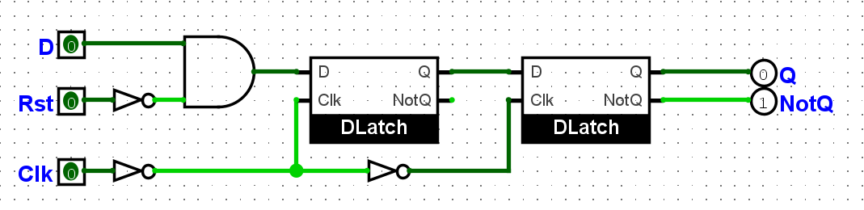
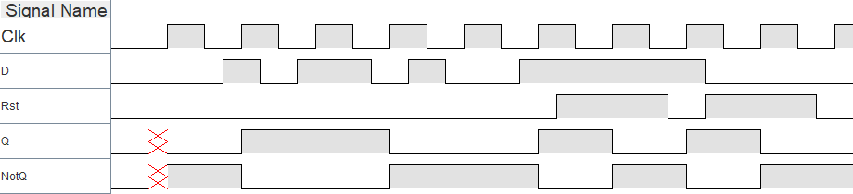
Exercise 1: D Flip-Flop

Slide 3
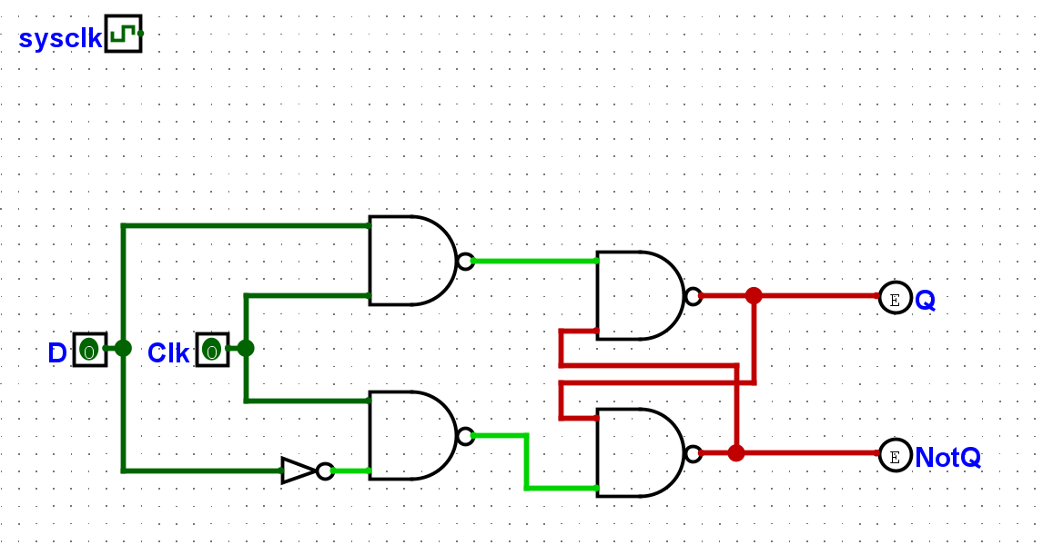
D latch

Slide 4
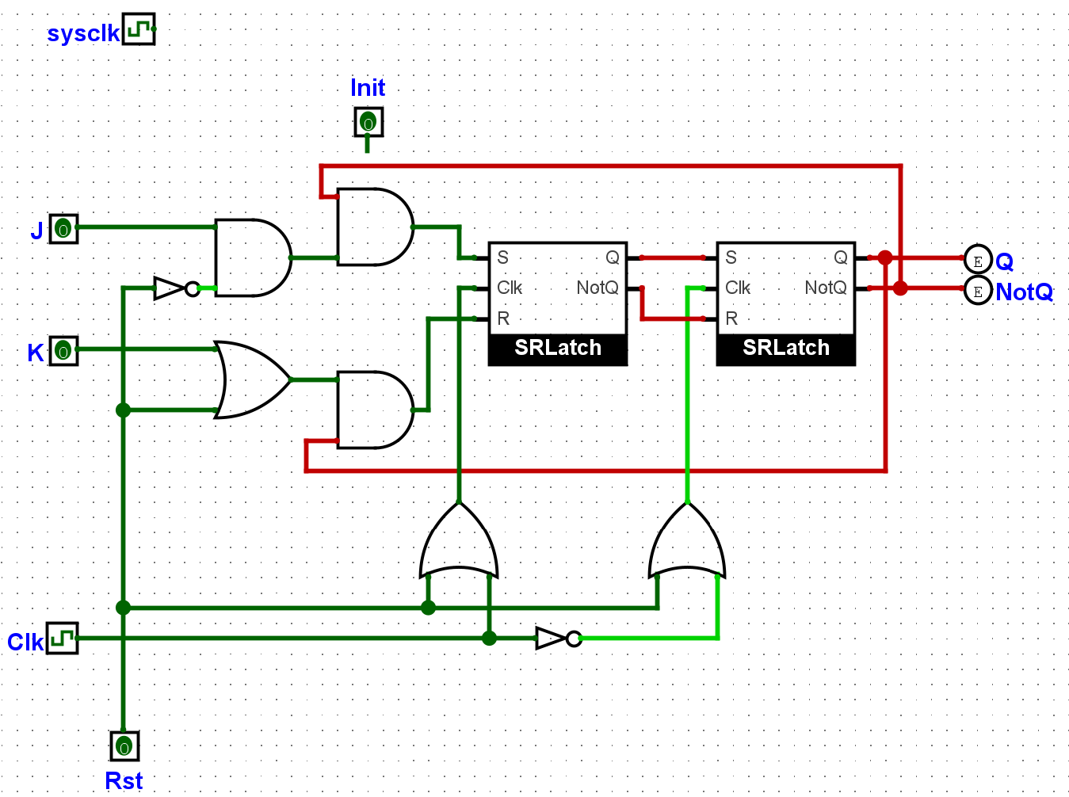
Exercise 2: JK Flip Flop

Slide 5
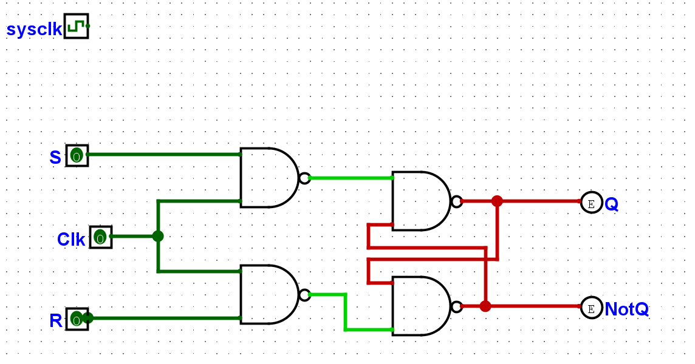
SR latch

Slide 6
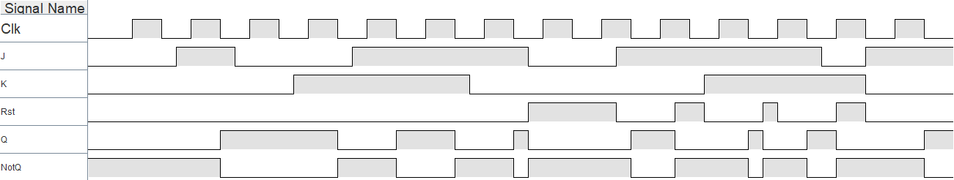
JK Flip-Flop chronogram

Slide 7
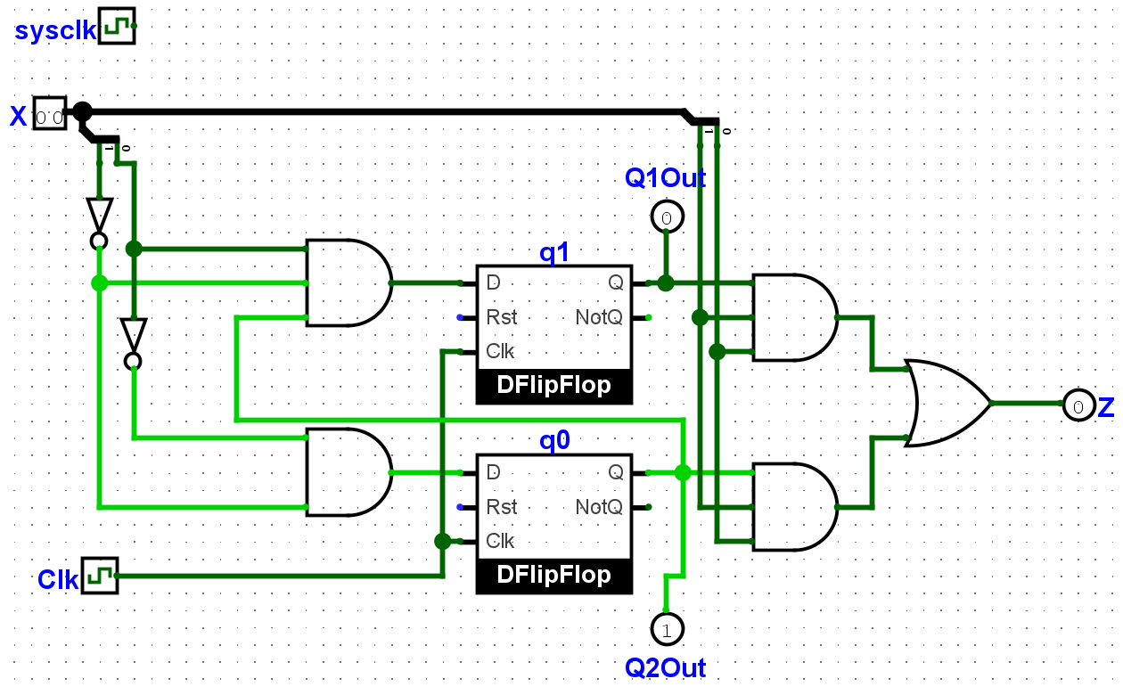
Exercise 3: Sequence Detector

Slide 8
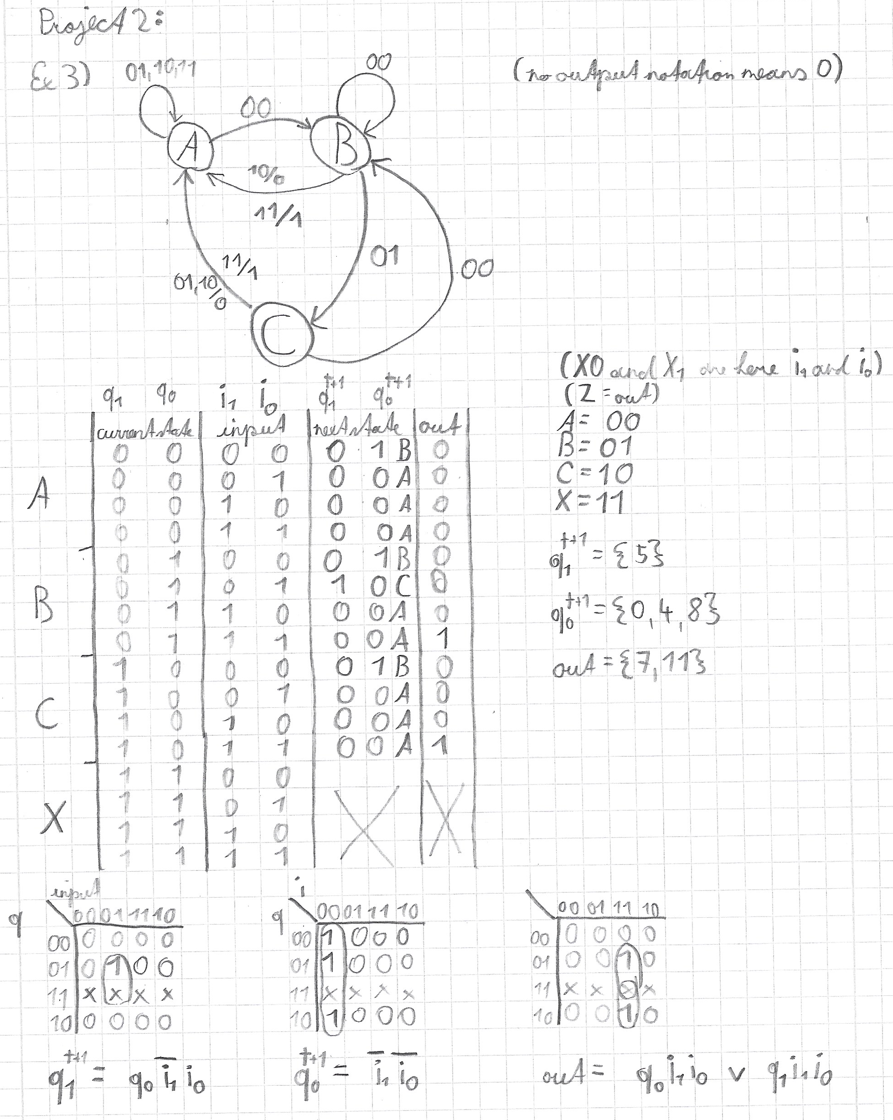
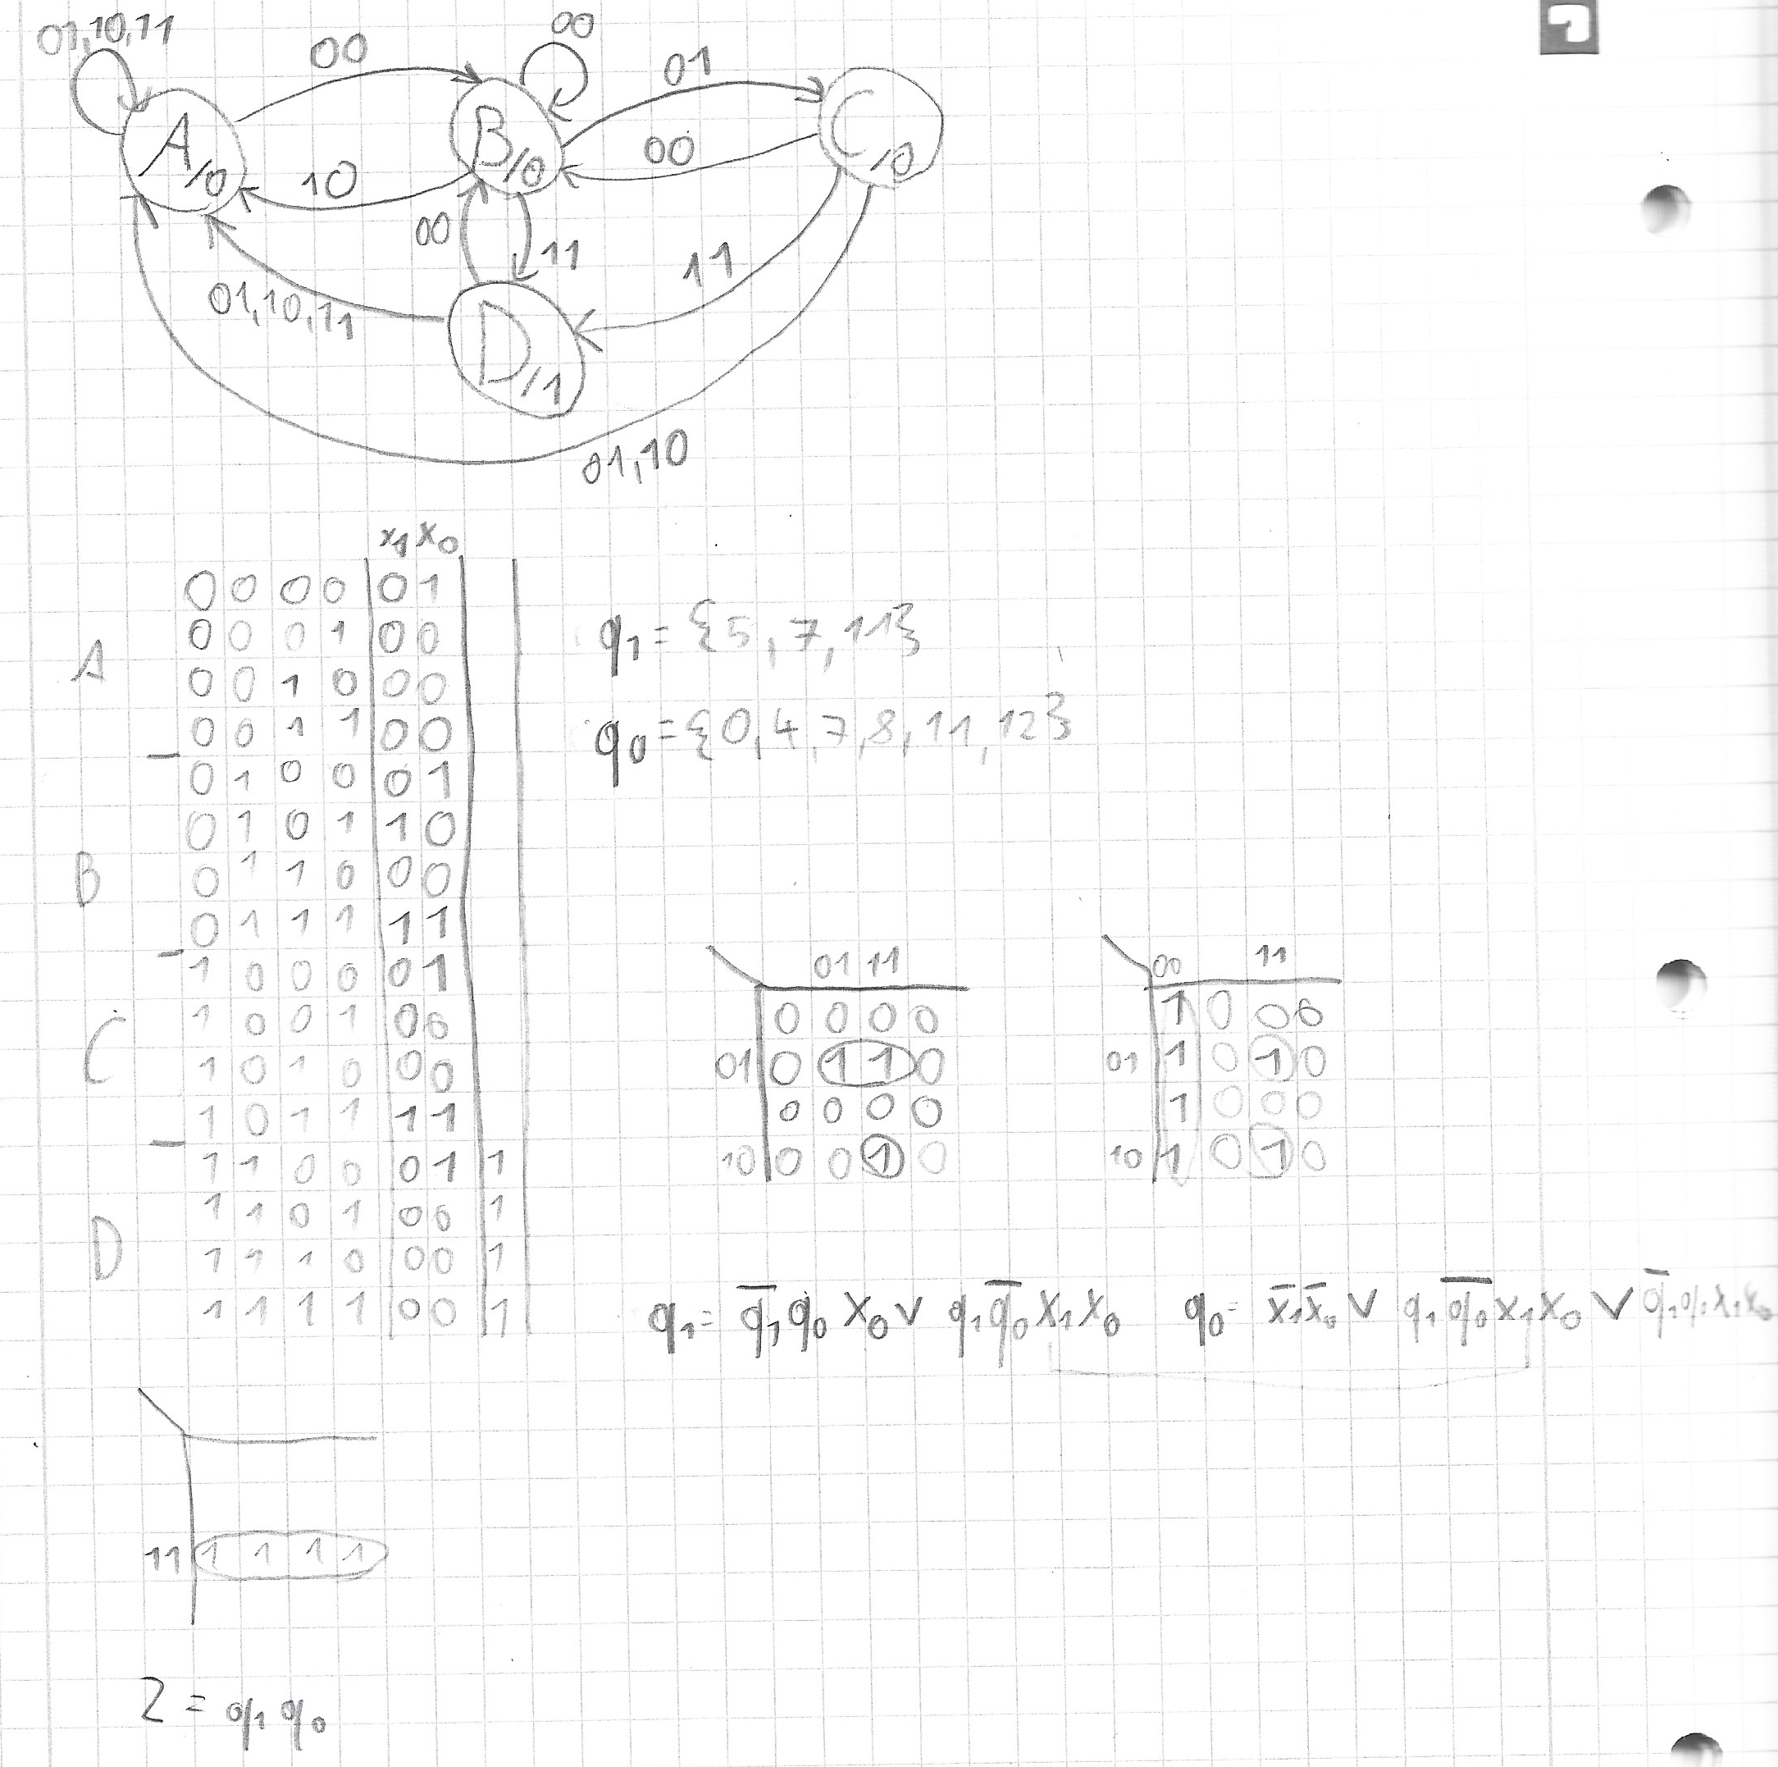
Subtasks

Slide 9
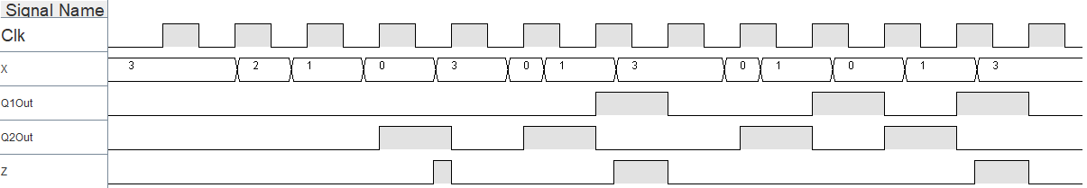
Sequence Detector chronogram

Slide 10
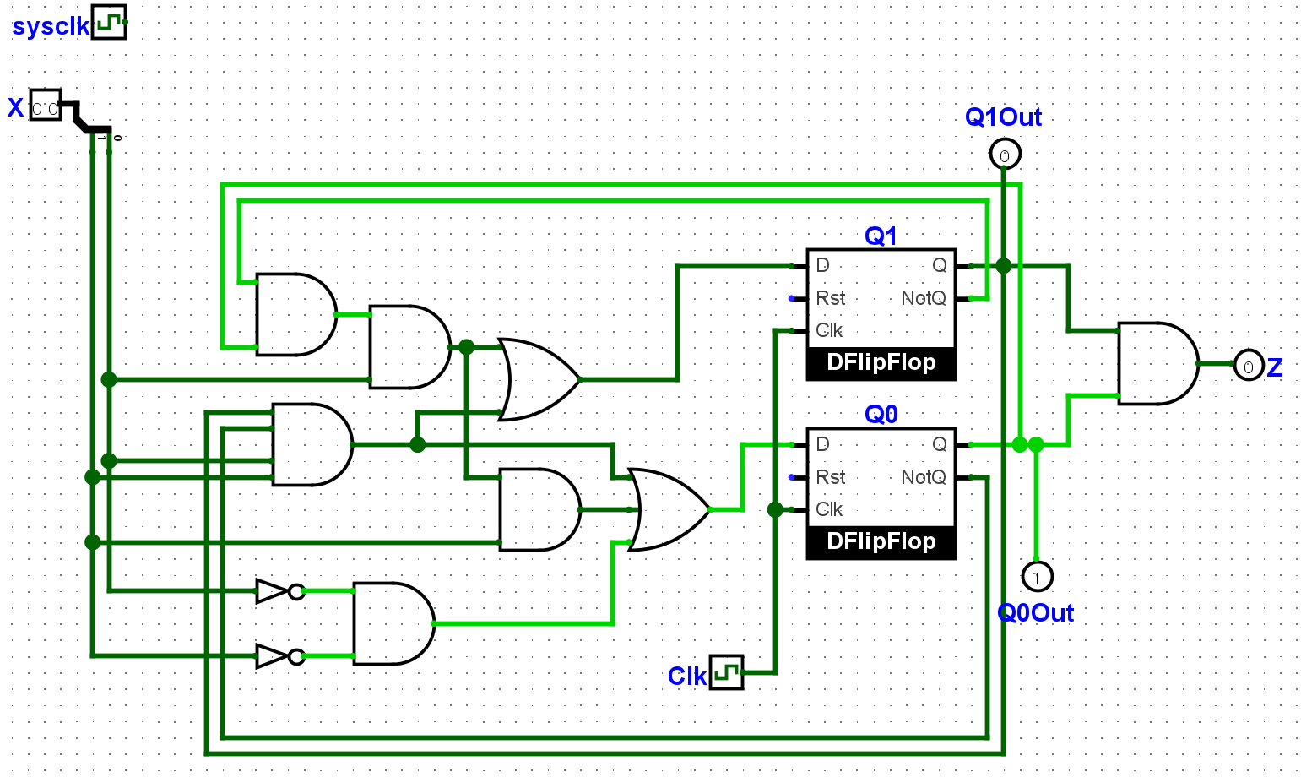
Sequence Detecor Moore

Slide 11
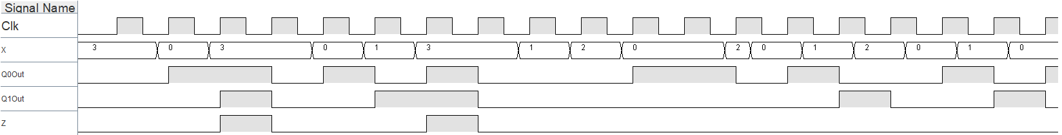
Chronogram

Slide 12
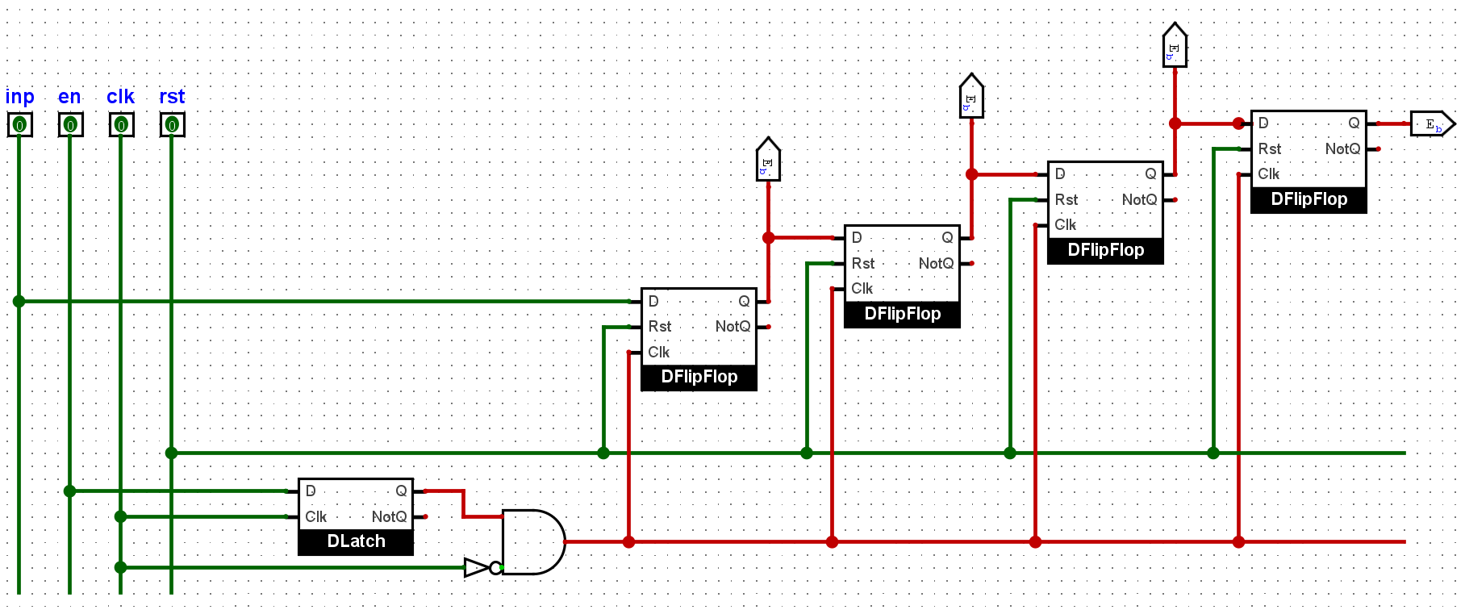
Exercise 4: Shift Register 1 bit

Slide 13
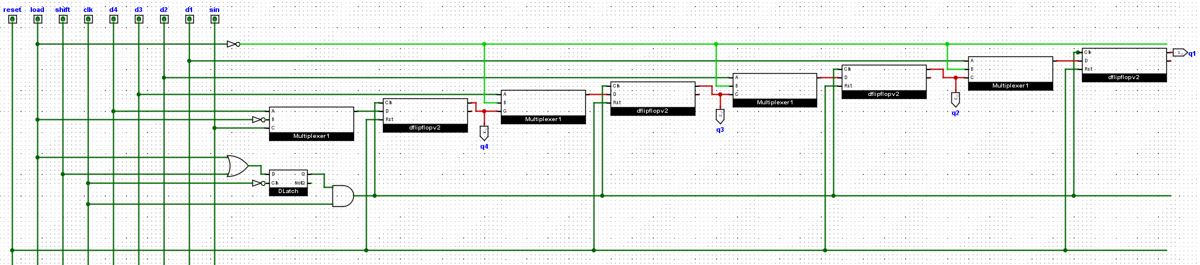
Exercise 4: Shift Register 4 bit

Slide 14
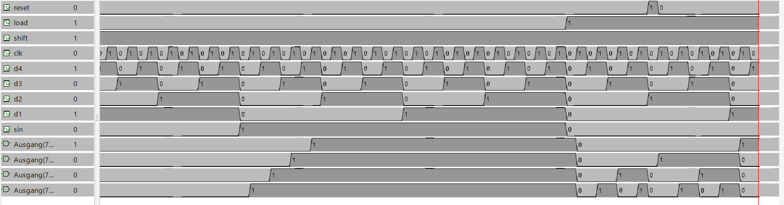

Slide 15
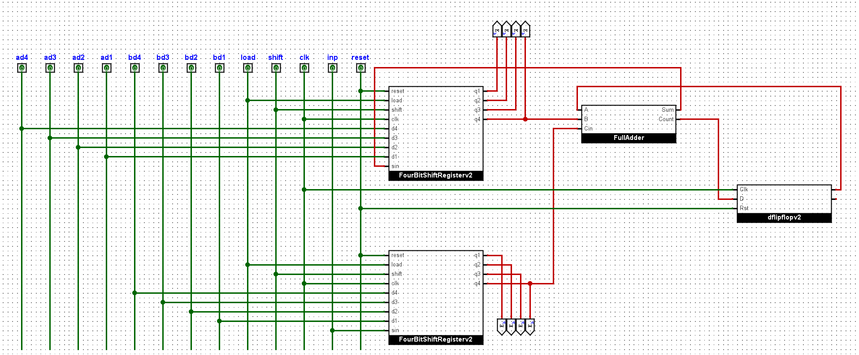
Exercise 5: Serial Adder

Slide 16
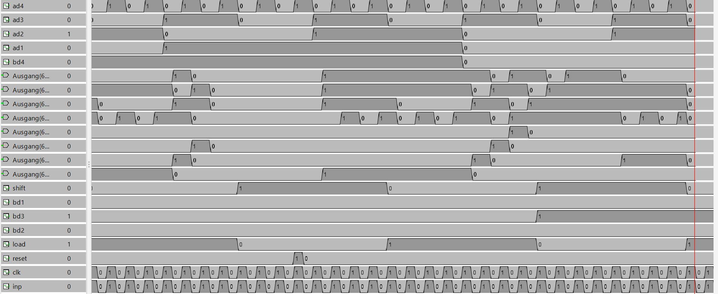

Slide 17
Subtasks

